Slide 1
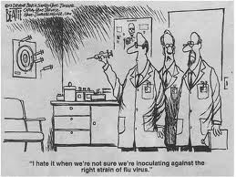
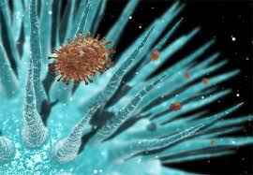
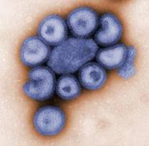
Infectious Diseases
Lesson 4.5

Slide 2
Lesson Objectives:
After finishing today’s lesson, you will be able to:
explain how pathogenic viruses constantly adapt.
compare and contrast antigenic drift and shift.
relate the concepts of antigenic drift and shift to flu vaccines.

Slide 3
Do Now
Brainstorm: The 1918 flu appeared suddenly and killed millions of people. Where does such a virus come from?
Viruses, like bacterial pathogens, mutate randomly every time they replicate.
The mutation can have no effect.
The mutation can produce a virus that is defective in some way.
The mutation can help the virus cause worse disease or spread better.

Slide 4
Activity I: Influenza life-cycle diagram
Study the diagram on the flu virus replication and fill in the diagram in your worksheet.

Slide 5
Discussion
When a virus infects a cell and uses it to make new viruses, are the new viruses completely identical to the infecting virus? Why or why not?
Every time a viruses replicates in a host cell there are small or major changes in its genome.
If changes happen, what is their effect?
Sometimes the changes do nothing, other times the changes lead to less or more virulent viruses.

Slide 6
Activity II: Modeling Antigenic Shift and Drift
Do the activity and answer the questions on your worksheet.

Slide 7
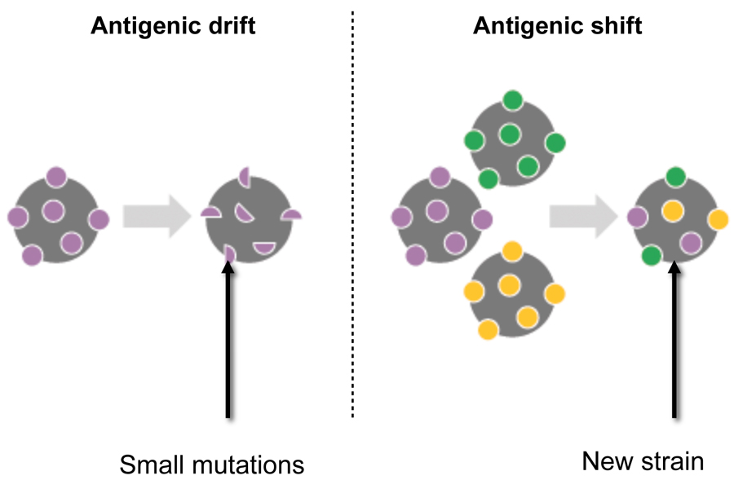
Antigenic drift and Antigenic shift
Surface proteins
Only some viruses can do this because
it requires a segmented genome!

Slide 8
Viruses with non-segmented genomes
New viruses A: same as infecting
Virus A
New viruses B: same as infecting
Virus B

Slide 9
Viruses with segmented genomes
C and D infect a host cell at the same time!
New viruses C:
genome is a mix of C and D
New viruses D:
genome is a mix of C and D

Slide 10
Wrap Up
Influenza has a segmented genome. How might this impact outcomes of the flu vaccine?

Slide 11
Homework
Complete the homework worksheet with the flu vaccine case study.

